Slide 1
Classification and Prediction ——Issues Regarding Classification and Prediction——
徐华
清华大学 计算机系 智能技术与系统国家重点实验室
xuhua@tsinghua.edu.cn

Slide 2
Classification and Prediction
Basic Concepts
Issues Regarding Classification and Prediction
Decision Tree
Bayesian Classification
Neural Networks
Support Vector Machine
K-Nearest Neighbor
Associative Classification
Classification Accuracy

Slide 3
Issue 1: Data Preparation
Data cleaning
Preprocess data in order to reduce noise and handle missing values
Relevance analysis (feature selection)
Remove the irrelevant or redundant attributes
Data transformation
Generalize and/or normalize data

Slide 4
Issue 2: Evaluating Classification Methods
Accuracy
classifier accuracy: predicting class label
predictor accuracy: guessing value of predicted attributes
Speed
time to construct the model (training time)
time to use the model (classification/prediction time)
Robustness: handling noise and missing values
Scalability: efficiency in disk-resident databases
Interpretability
understanding and insight provided by the model
Other measures, e.g., goodness of rules, such as decision tree size or compactness of classification rules

Slide 5
Evaluation Criteria
Accuracy on test set
The rate of correct classification on the testing set. E.g., if 90 are classified correctly out of the 100 testing cases, accuracy is 90%.
Actual evaluation in research work for several times.
Error Rate on test set
The percentage of wrong predictions on test set.
Confusion Matrix(混淆矩阵)
For binary class values, “yes” and “no”, a matrix showing true positive, true negative, false positive and false negative rates
Speed and scalability
The time to build the classifier and to classify new cases, and the scalability with respect to the data size.
Robustness: handling noise and missing values

Slide 6
Evaluation Criteria
 |  | Predicted class
 |  | Yes | No
Actual class | Yes | True positive | False negative
 | No | False positive | True negative

Slide 7
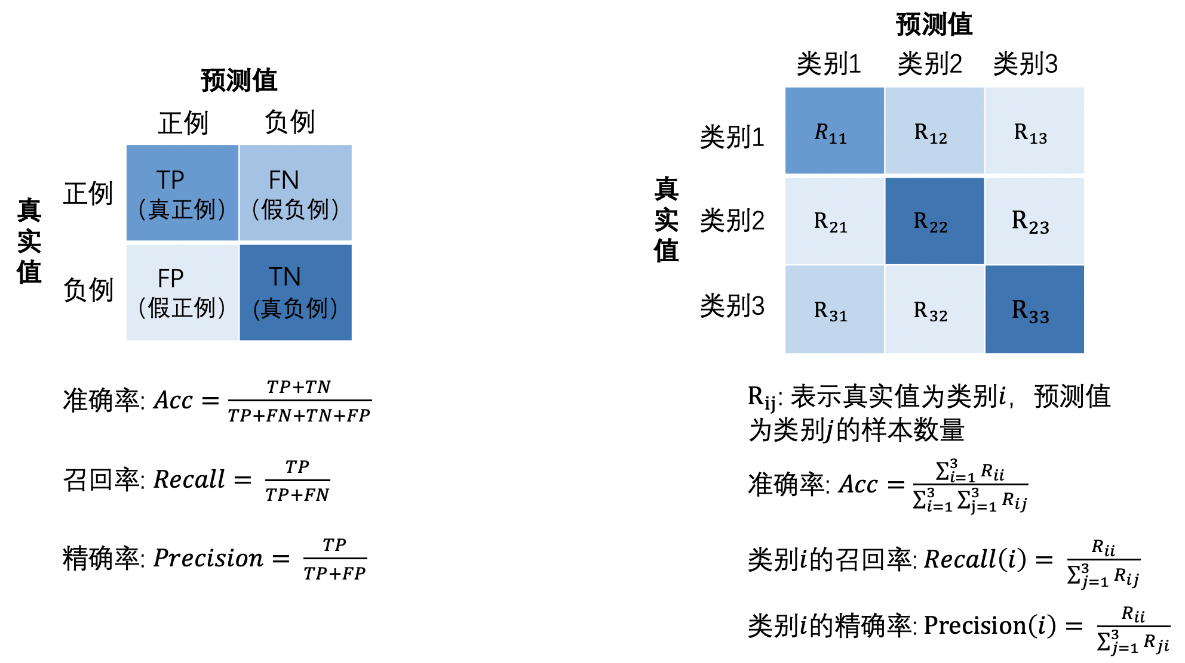
Evaluation Criteria

Slide 8
Evaluation Techniques
Holdout: the training set/testing set.
Good for a large set of data.
k-fold Cross-validation(交叉验证):
divide the data set into k sub-samples.
In each run, use one distinct sub-sample as testing set and the remaining k-1 sub-samples as training set.
Evaluate the method using the average of the k runs.
This method reduces the randomness of training set/testing set.

Slide 9
Issue 3: A Complete Classification Flow
Single Modal Information v.s. Multi-modal Information
Single Modal Information
Multi-Modal Information

Slide 10

Issue 3: A Complete Classification Flow—— Unimodal Information and Multi-modal Information
Unimodal Information: Data, text, audio (signal), video/picture, etc.
Typical Multimodal Information：
Short video: TikTok/KuaiShou platform consumers’ comments on products/services
TCM “Four Diagnosis" information: inspection (picture data), listen (audio information), question (text information), feel (pulse diagnosis-signal data)
Other Multi-modal information: gestures, postures, lip shapes, etc., here we focus on the information of different physical modalities
Video / Picture Information
-> Look(face, tongue, eye)
Audio Information
-> Listen (voice), pulse (signal) data
Text Information
-> Question (medical record) data

Slide 11


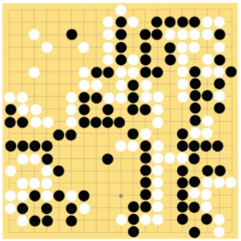
Issue 3: A Complete Classification Flow—— Feature Engineering and Feature Learning Representation（1）
Classification of unimodal information (typical problems of machine learning, function mapping problems)
Data Binarization Processing
f (x) = 1 or -1
Speech Recognition
Image Processing
Smart Game(Go)
Machine Translation
“Hello”
“9”
“6-5”
(Placement position)
“你好！”
“Hello!”

Slide 12
Issue 3: A Complete Classification Flow—— Feature Engineering and Feature Learning Representation （2）
Classification Mapping
Supervised learning classifier (classification: traditional machine learning, deep neural network)
Unsupervised learning classifier (clustering)
Semi-supervised learning classifier (reinforcement learning problem: the case of small sample calibration data set)
How to obtain the characteristic description x of different modal information？
Data Classification
Structured data: Data, information in the database
Semi-structured data: News page content
Unstructured data: Pictures, videos (timing information), audio (timing information), etc.
Feature Representation Method
Feature Engineering Method
Based on Learning Representation：Learning into a feature space vector through a data-driven mechanism

Slide 13
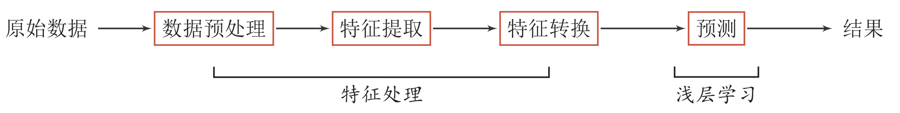
Issue 3: A Complete Classification Flow—— Feature Engineering and Feature Learning Representation （3）
Features and Classification（1）
Feature Engineering
Text：Letters, morphology, syntax, etc.
Pictures：Colors, textures, collection features, etc.
Video：Picture features + Temporal information
Audio：Signal features
Classification model based on feature engineering
特征工程（Feature Engineering）

Slide 14
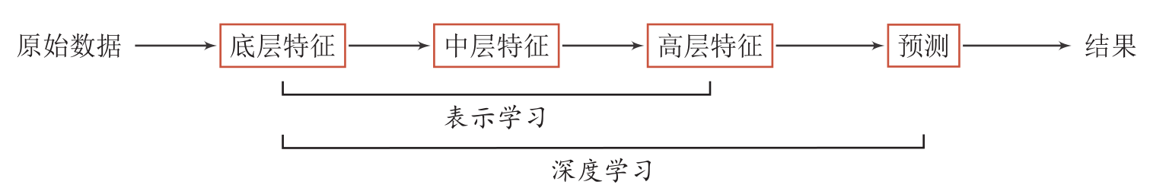
Issue 3: A Complete Classification Flow—— Feature Engineering and Feature Learning Representation （4）
Features and Classification（2）
Learning Feature Representation and Classification
By building a model with a certain "depth", the model can automatically learn a good feature representation (from low-level features, to middle-level features, and then to high-level features), thereby ultimately improving the accuracy of prediction (classification) or recognition.

Slide 15
Issue 3: A Complete Classification Flow—— Feature Engineering and Feature Learning Representation （5）
Features and Classification（3）
Which features of the unimodal information need to be fused? How to integrate? (Is the feature linear or vectorized?)
At which level and which characteristics of multi-modal information need to be fused? How to integrate?
How to determine the weight of the fused features according to the classification effect during the fusion process?
Feature engineering features
(extraction and selection)
∑
Represents Learning
(Depth feature)
Text
(Question)
Feature engineering features
(extraction and selection)
∑
Feature Fusion
Classification/Prediction:
f(∑ )
∑
Audio/Signal
(Pulse Diagnosis)
Represents Learning
(Depth feature)
Feature engineering features
(extraction and selection)
∑
Represents Learning
(Depth feature)
Picture/Video
(Look: Face / Tongue Diagnosis)

Slide 16
Thanks！
Notes:
工作新意图发现

